Slide 1
EBS 217 DESIGNING INSTRUCTIONAL MATERIALS USING ICT TOOLS

Slide 2
Objectives
By the end of the unit, students would be able to;
discuss learning by design
explain what is meant by teacher design teams
state at least five principles in designing activities
define interactive lectures
state three ways used in evaluating the quality of design

Slide 3
Approach: Teachers Learning Technology by Design
Learning by design: it seeks to put teachers in similar roles as they work collaboratively in small groups to develop technological solutions to authentic pedagogical problems.
They focus on a problem of practice
Seek ways to use technology (and thereby learn about technology) to address the problem
Their exploration about technology are tied to their attempts to solve educational problems
Being designers to technology not passive users.

Slide 4
Cont…
The aim is for students to learn content deeply and at the same time develop the skills and understanding needed to undertake solution of complex, ill-structured problems.
This is accomplished by having students learn in the context of trying to achieve design challenges. Rather than memorizing facts to be reproduced on tests, students become involved in the concepts being covered and learn them in services of completing the design challenge before them.

Slide 5
Cont…
As they work towards successfully achieving design challenges, they get practice designing, analyzing data and drawing conclusions, making informed decisions and justifying them with evidence, collaborating, and communicating. They not only learn facts; they also learn practices and reasoning and how to apply the facts and skills they are learning.

Slide 6
Teacher Design Teams (TDT)
Definition: design teams can be defined as a group of individuals working collaboratively to design and develop ICT- based solutions to authentic pedagogical problem faced by teachers. Teacher design team promotes:
Active learning (learn by doing, learn through problem solving processes)
Local ownership (not just a consumer of technology)
Collaboration (learn/teach each other, focus on practical problem from different perspectives)
Sensitive to their subject matter and instructional goal

Slide 7
Usefulness
Specific form of teacher collaboration in curriculum design
- Collaboration of several teachers concerned with consciously redesigning their curriculum
Improve the teaching process
- Professional development of teachers
Fruitful means for educational reform
Building of cohesion in the staff
Realising a better curricular product
Teachers developing their own practice and enacting/using it within the school curriculum
Teachers having a sense of ownership of product

Slide 8
Design of learning activities
According to Thiagi, effective instruction has three components:
1. Content related to the instructional objectives
2. Activities that require learners to process the content and to provide a response
3. Feedback to learners to provide reinforcement for desirable responses and remediation for undesirable responses

Slide 9
Cont…
It is important to rethink the use of lecture-presentations.
While a lecture is a valid form of instruction, it does not necessarily lead to deep learning because it positions the participants as passive recipients of information.
For a lecture to be effective, it must first of all be the most appropriate means for achieving the learning outcomes.
In addition, the lecturer has to be not only knowledgeable about the subject matter but also engaging and motivating.
And the lecture must be done in an interactive way, or in combination with short participatory activities.

Slide 10
Principles of designing learning activities
1) Integrate content and activity to focus on key content and foster active learning.
2) Design and implement activities that help learners to master the content and strengthen their critical thinking, creativity, problem-solving and decision-making skills.
3) Be guided by your target learning outcome/s. Choose content and learning activities according to the target learning outcomes.

Slide 11
Cont…
4) Engage in authentic learning: Use real-life examples and simulations of real-life activities, such as making an assessment, analyzing a problem, identifying solutions, and making a proposal.
5) Help participants build on prior knowledge and professional experience and make connections between these and the training content. Design activities to get participants with varied levels of experience and expertise on the topic.

Slide 12
Interactive lectures
It fosters active learning by getting learners to engage with the content by answering a question, interpreting a case or situation, or solving a problem.
The activities are designed to allow everyone to participate, and increase their chances of retaining what they are learning through immediate practice.
For instructors or lecturers, the activities provide feedback on the level and extent of understanding of the topic.

Slide 13
The process
For the development of curriculum materials, teacher education programmes, interventions
Cycle approach to design and formative evaluation
Preliminary investigation
-Problem analysis
-Context analysis
-State-of –art knowledge
Try-out: by two teachers in their classrooms
User appraisal: by teachers in the department
Field-try out: six teachers use the support material in their classrooms
Development
of prototype
1st draft
2nd draft
3^{rt} draft
Final version
Combination of preliminary study, expert review (validity), try-out and appraisal by users (practicality), and field-test (achievement)

Slide 14
Ways forward (1)
Teacher support materials,
Showing ‘how to do it’
By way of procedural specifications
Focus on:
-Lesson preparation (computer-based program)
-Subject content
-Lesson execution
-Assessment of learning

Slide 15
Ways forward (2)
Professional development
Preferably in combination with exemplary curriculum materials
Should model the classroom situation, or
Should be in the classroom

Slide 16
Criteria for evaluating the quality of the design (product/process)
Validity/legitimacy (ideal/formal)
Is the design based on state-of the-art knowledge?
Practicality (consistency intended perceived/operational)
Can the design be implemented?
Effectivity (consistency intended-experiential/attained)
Does the design achieve what it aimed for: learning effects
Cost - benefits

Slide 17
Instructional Design

Slide 18
Objectives
By the end of this unit, students will be able to:
Define instructional design in their own words.
State ways in which instructional design assist educators.
Identify the basic steps of instructional design.
Identify the characteristics of instructional design.
Describe the ADDIE model.
Give details of other models {discussed in class).

Slide 19
Instructional design
Instructional design can be defined as “the systematic process of translating principles of learning and instruction into plans for instructional materials and activities (Wulfrek and Ellis, 1983).

Slide 20
Cont…
According to Albion et al., instructional design can be defined as a
process,
discipline,
science, or
reality

Slide 21
Instructional Design as a Process
It is the systematic development of instructional specifications using learning and instructional theory to ensure the quality of instruction.
It is the entire process of analysis of learning needs and goals and the development of a delivery system to meet those needs. It includes development of instructional materials and activities and try-out and evaluation of all instruction and learner activities.

Slide 22
Instructional Design as a Discipline
ID is that branch of knowledge concerned with
research and theory about instructional
strategies and the process for developing and
implementing those strategies.

Slide 23
Instructional Design as a Science
ID is the science of creating detailed specifications
for the development, implementation, evaluation
and maintenance of situations that facilitate the
learning of both large and small units of subject
matter at levels of complexity.

Slide 24
Instructional Design as Reality
ID can start at any point in the design process. Often a glimmer of an idea is developed to give the core of an instruction situation.
By the time the entire process is done the designer looks back and she or he checks so that all parts of the ‘science’ have been taken into account. Then the entire process is written up as if it occurred in a systematic fashion.

Slide 25
Steps in instructional design Steps in the Instructional Design Process
There are six basic steps in instructional design:
1) Analyze your learners and the learning context.
2) Define your learning outcomes (knowledge-attitudes-skills).
3) Structure the learning content.
4) Select the learning materials or resources.
5) Design the learning activities.
6) Determine the modes of assessment.

Slide 26
Cont…
In performing each step, an instructional designer seeks to answer the following basic questions:
Who are our learners? What do they already know and how do they learn best?
2) What do we want our learners to learn? Why?
3) How do we structure the learning to achieve our learning objectives?
4) What learning resources are appropriate, effective, and available?
5) What strategies will we use to ensure that effective learning takes place?
What combination of activities will enable the learners to achieve the
learning objectives?
6) How do we know whether the learners are learning/have learned what
they are supposed to learn? How do we assess learning?

Slide 27
Instructional Design Con’t
A systematic process of Instructional Design enables an educator to:
Identify the performance problem
Determine the goals and objectives
Define your learners and their needs
Develop strategies to meet needs and goals
Assess learning outcomes
Evaluate if goals, objectives and needs are met

Slide 28
Characteristics of instructional design
According to Branch and Merrill (2002), there are characteristics that should be present in all instructional design models:
Instructional design is learner centered: Learner and
his/her performance are the focal point.
2. Instructional design is goal oriented: Well defined
goals are essential.

Slide 29
Cont…
Instructional design focusses on real world
performance. Help learners perform the behaviors that
will be expected of them in the real world.
Instructional design focusses on outcomes that can be
measured in a reliable and valid way. Creating valid
and reliable measurement instrument is essential.
Instructional design is empirical. Data are the heart of
the process.
Instructional design typically is a team effort. This
process usually involves team work.

Slide 30

A Useful Model For Designing Instructional Materials Is The
ADDIE MODEL

Slide 31
ADDIE Model
The ADDIE model is used by instructional designers and training developers. It is composed of five phases
Analysis,
Design,
Development,
Implementation, and
Evaluation
This model attempts to save time and money by catching problems while they are still easy to fix.

Slide 32
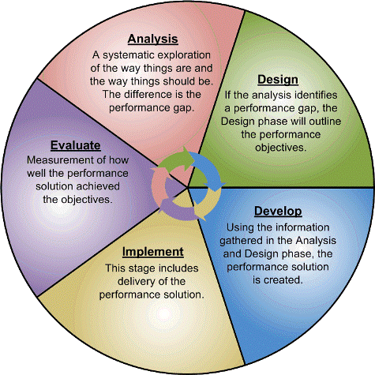
ADDIE Model

Slide 33
ADDIE Model : A = Analysis
In the analysis phase, the instructional problem is clarified, the instructional goals and objectives are established, and the learning environment and learner's existing knowledge and skills are identified.
Below are some of the questions addressed during the analysis phase:
Who are the learners and what are their characteristics?
What is the desired new behavioral outcome?
What types of learning constraints exist?
What are the delivery options?
What are the pedagogical considerations?

Slide 34
ADDIE Model : D = Design
The design phase deals with learning objectives, assessment instruments, exercises, content, subject matter analysis, lesson planning and media selection.
The design phase should be systematic and specific.
Systematic means a logical, orderly method of identifying, developing and evaluating a set of planned strategies targeted for attaining the project's goals.
Specific means each element of the instructional design plan needs to be executed with attention to details.

Slide 35
Cont…
These are steps involved in design phase:
Document the project's instructional, visual and technical design strategy
Apply instructional strategies according to the intended behavioral outcomes by domain (cognitive, affective, and psychomotor).
Design the user interface and/or user experience
Create prototype
Apply visual design (graphic design)

Slide 36
ADDIE Model : D = Development
Development of instruction
Generate lesson plans (different from lesson planning) and lesson materials. Instructional designers and developers create and assemble the content assets that were blueprinted in the design phase.
Complete all media & materials for instruction, and supporting documents.
End result is a course or workshop ready for delivery. The project is reviewed and revised according to the feedback received.

Slide 37
ADDIE Model : I = Implementation
The delivery of the instruction.
Purpose is effective & efficient delivery of instruction.
The teachers should cover the course curriculum, learning outcomes, method of delivery, and testing procedures.
Promote students’ understanding of material & objectives, and ensure transfer of knowledge.
Preparation of the learners includes teaching them on new tools (software or hardware).

Slide 38
ADDIE Model : E = Evaluation
Two related evaluations going on simultaneously in most ID situations.
Formative Evaluation: It is present in each stage of the ADDIE process.
Summative Evaluation: It consists of tests designed for domain specific criterion-related referenced items and providing opportunities for feedback from the users which were identified.

Slide 39
Other Useful Models
necessary For Designing Instructional Materials

Slide 40
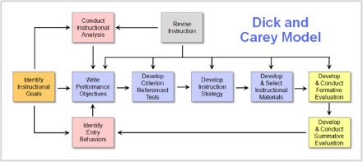

Slide 41
Cont…
Stage 1. Instructional Goals-The first step is to figure out the instructional goals. This means that you are able to, or will be able to, identify what it is the students need to learn.
Stage 2. Instructional Analysis- Instructional analysis is the second step. This means you are determining the skills that your students will need to learn what you plan to teach them.
Stage 3. Entry Behaviors and Learner Characteristics- Next you have to assess which skills the students have out of those that you previously determined are needed for this lesson. These skills will be crucial to the lesson’s success with each student.
Stage 4. Performance Objectives- Next, you must figure out specific goals and objectives for the lesson. These objectives must be detailed. Details will help you make sure you are teaching your students what matters most from the lesson.
Stage 5. Criterion-Referenced Test Items-The fifth thing you must do is to create a test (consistent with the performance objectives) that will reflect what you’re hoping to teach the students. Referring back to notes you have made will help you figure out what to test. These are meant to help the students understand what they have or have not mastered yet, and are a checkpoint for the parents or administrators.

Slide 42
Cont…
Stage 6. Instructional Strategy- Sixth, you begin to outline your lesson plan. This means that you will be able to demonstrate what you want them to learn, add activities, and decide how each segment will be done. If you want to have group activities, now is the time to decide when and what materials will be covered by the activity.
Stage 7. Instructional Materials- Seventh, you make sure you have what you need ready for the lesson. If you have something you already know will work, use it.
Stage 8. Formative Evaluation- Next, you would have to evaluate how the lesson went. Were there some students who weren’t too thrilled with the group work? Did your groups not work well? Did some students sit back while others did all the work, expecting to ride along for a good grade? You could use this time to go for a field trip or to work in smaller groups. You could even do one on one if you have a small enough group.
Stage 9. Summative Evaluation- Ninth, you revise. If all you do is teach a class on a topic, you have a good opportunity to revise the class.

Slide 43
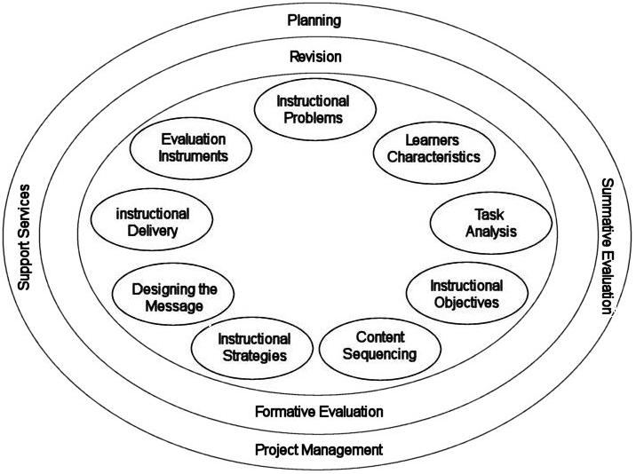
KEMP’S MODEL

Slide 44
The Kemp Instructional Design Model: Nine Core Elements
Determine the specific goals, and also identify potential instructional issues
Identify characteristics of learners that should be taken into account during the planning process
Clarify course content, and analyze the proposed task components in relation to the stated goals and purposes of the course
Define instructional objectives and desired learning outcomes
Ensure that content for each instructional unit is structure sequentially and logically to facilitate learning
Design instructional strategies to enable individual learners to master the content, and achieve desired learning outcomes
Plan the instructional message and the appropriate mode of delivery
Develop evaluation instruments suitable for measuring and assessing learners’ progress towards achieving course objectives
Choose the appropriate resources that will support both teaching and learning activities

Slide 45
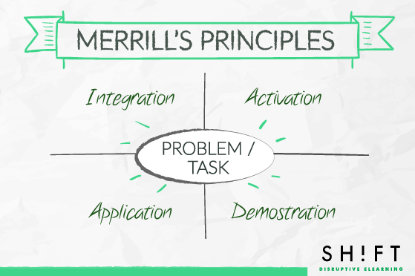

Slide 46
Merrill’s Principles
The principles promote learning in the following manner:
Learning starts with real-world problems. Students should be able to relate to problems and tasks they can handle. (Task-centered)
A course must activate existing knowledge base of the learner; hence aiding them connect previous knowledge with the new one. (Activation )
A course must demonstrate the knowledge (both visually and through story telling) so that it leverages different regions of the brain, hence retaining it longer. (Demonstration)
Allow them to apply new information on their own. Let them practice and learn from their mistakes. Let them see how your new material works in concrete situations. (Application)
The course must offer possibilities for integrating the knowledge into the learner’s world through discussion, reflection, and/or presentation of new knowledge. (Integration )

Slide 47
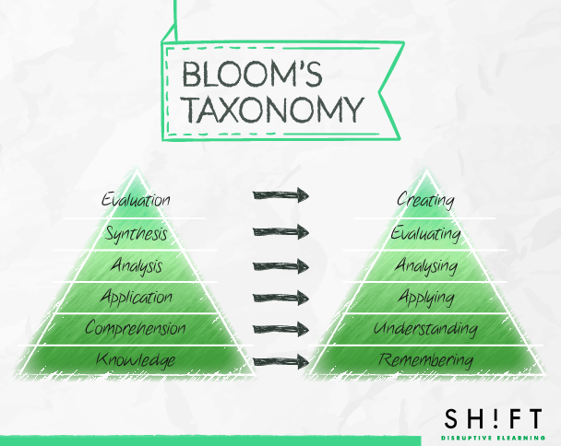

Slide 48
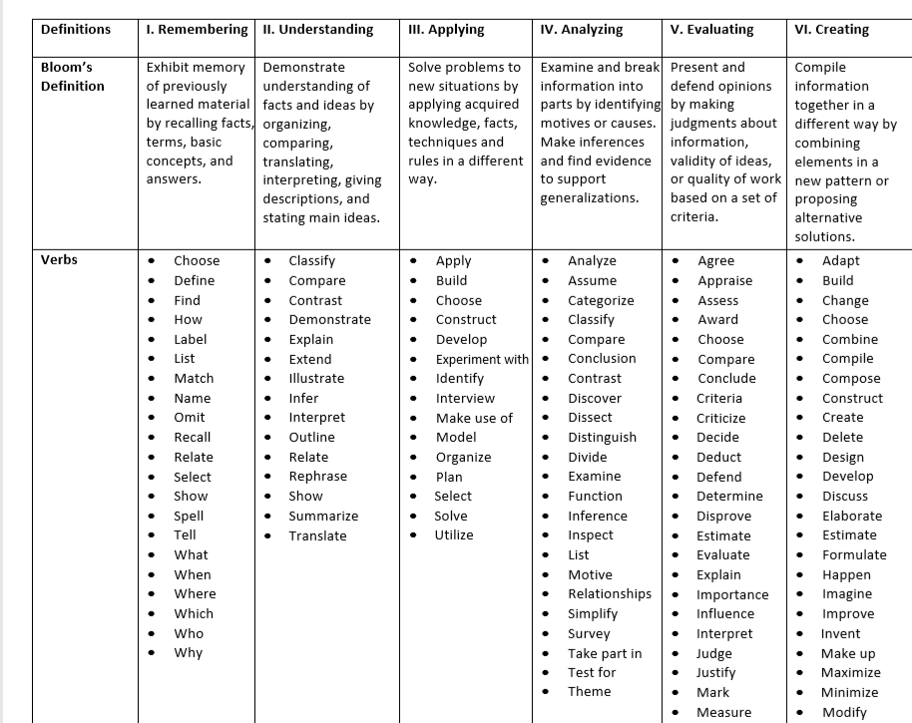

Slide 49
Gagné’s Nine Events of Instruction
Gain attention - Curiosity motivates students to learn.
Inform learners of objectives - These objectives should form the basis for assessment.
Stimulate recall of prior learning - Associating new information with prior knowledge can facilitate the learning process.
Present the content - This event of instruction is where the new content is actually presented to the learner.
Provide “learning guidance” - use of examples, non-examples, case studies, graphical representations, mnemonics, and analogies.
Elicit performance (practice) - Eliciting performance provides an opportunity for learners to confirm their correct understanding, and the repetition further increases the likelihood of retention.
Provide feedback - guidance and answers provided at this stage are called formative feedback.
Assess performance - take a final assessment.
Enhance retention and transfer to the job - Effective education will have a "performance" focus.

Slide 50
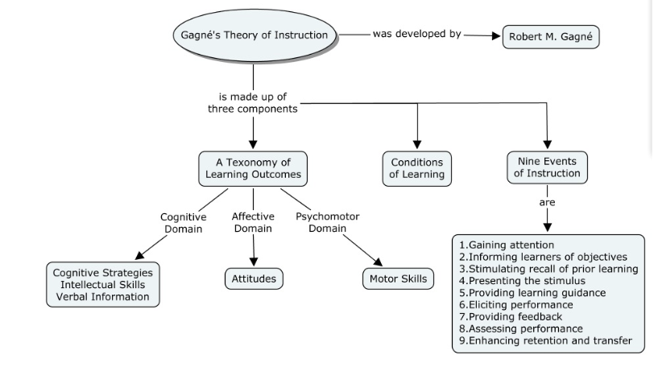

Slide 51
1.Gain attention (reception) | Begin the lesson with a startling statement/statistic, a rhetorical question, a provocative quotation or a challenge that can motivate learners’ "need to know" and establish a common ground to address an existing deficiency, gap or problem. Use humour, vary media, and get students involved; these are elemental to effective communication.
2. Inform learners of the objectives (expectancy) | Review course objectives with students. Explain how meeting the objective is useful to the students in terms of real-world applications.
3. Stimulate recall of prior learning(retrieval) | Pre-test prior knowledge and prerequisite skills. Ask students to share their current perceptions of the topic. Create a concept map of prior knowledge. Provide students with advance organisers in order to help learners make their own bridges between concepts and learn them
4. Present the stimulus(selective perception) | Lecture in small chunks whenever possible. Use a variety of media and methods in presenting information. Show examples to clarify concepts.
5. Provide learner guidance(semantic encoding) | Highlight important ideas, concepts, or rules. Use repetition. Provide students with learning strategies such as pneumonic memory techniques.
6. Elicit student performance (responding) | Allow for several practice2 sessions over a period of time. Provide role-play, case studies, or simulations. Provide opportunities for knowledge acquisition through collaboration, discussion and negotiation by assigning group projects where students “meet” online
7. Provide feedback(reinforcement) | Feedback should be immediate, specific, and corrective. Allow additional practice opportunities after feedback is given.
8. Assess Performance(retrieval)¾ | Provide independent activities that test student knowledge/skill acquisition
9. Enhance retention and transfer (generalization) | Highlight connections with other subject areas. Apply learning in real-world situations by linking learning experience with personal life events of learners to make the experience more memorable to them.

Slide 52
Reigeluth’s Elaboration Theory
Organizing Course Structure: Single organisation for complete course
Simple to complex: start with simplest ideas, in the first lesson, and then add elaborations in subsequent lessons.
Within-lesson sequence: general to detailed, simple to complex, abstract to concrete.
Summarizers: content reviews presented in rule-example-practice format
Synthesizers: Presentation devices that help the learner integrate content elements into a meaningful whole and assimilate them into prior knowledge, e.g. a concept hierarchy, a procedural flowchart or decision table, or a cause-effect model .
Analogies: relate the content to learners' prior knowledge, use multiple analogies, especially with a highly divergent group of learners.
Cognitive strategies: variety of cues - pictures, diagrams, mnemonics, etc. - can trigger cognitive strategies needed for processing of material.
Learner control: Learners are encouraged to exercise control over both content and instructional strategy. Clear labelling and separation of strategy components facilitates effective learner control of those components.

Slide 53
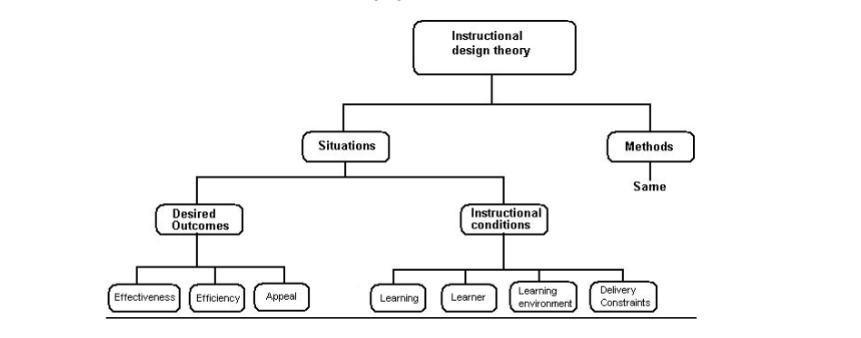

Slide 54
The ASSURE Model
The ASSURE model is a six-step instructional guide for planning and delivering technology-supported lessons with great focus on addressing learner needs.
ASSURE is an acronym for the description of six classroom procedures central to the informed selection and use of educational technology.
It highlights six classroom procedures: Analyze learners, State objectives, Select methods, media, and materials, Utilize media and materials, Require learner participation, and Evaluate and revise.

Slide 55
STRATEGY | DESCRIPTION
Analyze learners | General characteristics - grade, age, ethnic group, sex, mental, emotional, physical, or social problems, socioeconomic level, and soon. Specific entry competencies - prior knowledge, skills, and attitudes. Learning styles - verbal, logical, visual, and so on
State objectives /learning outcomes | The learning outcome may be primarily: Cognitive, Affective, and Psychomotor / Motor Skill
Select / modify instructional methods, media and materials | Choosing and using educational technology or media is a deliberate process, dependent for its success on having clear goals, and a rational and thoughtful method for matching characteristics with expected outcomes. Select the: Instructional method (e.g., a lecture, group work, a field trip, etc.) that is most appropriate to meet the objectives for the particular group of students. Materials relevant to the objectives. You can create your own materials or existing materials might be adopted and used as is or they might be adapted with suitable modifications. Media selection Media should be selected on the basis of instructional method, objectives and student needs. Students should have easy access to the selected media. Must be appropriate for the learning objectives and teaching format. Should be consistent with the students' capabilities and learning styles. No single medium is the total solution. Tutors and students should have the skills to use it.
Utilize media and materials | In order to utilize the media and materials listed above: Always preview the materials before using them and also use the media tools in advance to be sure it works. Don't assume that technology will always work, be ready with alternative plans. Prepare the learners: Give the students an overview, explain how they can use it and how they will be evaluated during the course.
Require learner participation | Incorporate questions and answers, self-assessments, discussions, group work, hands-on activities, and other ways of getting students actively involved in the learning process. Make sure that all students have opportunity to engage in the learning activities. Focus on student learning as opposed teaching them. Provide opportunities to manipulate the information Use strategies to get all students actively and individually involved in the lesson and allow time for practice during the demonstration of the skill.
Evaluate and revise | Involve evaluation student performance, media components and instructor performance. Reflect upon the stated objectives, the content, the instructional strategy, motivational strategies, the learning activities, the assessment, the time available to the students to study the content, and determine if they were effective or revise them until your students become successful learners.

Slide 56
Instructional Development Learning System (IDLS)
The components of the IDLS Model are:
Design a Task Analysis
Develop Criterion Tests and Performance Measures
Develop Interactive Instructional Materials
Validate the Interactive Instructional Materials

Slide 57
Prototypes
A prototype is a partial realization of a product constructed for the purpose of testing one or another characteristic of the design.
Using prototypes to test products in the early stages of development is far less expensive than waiting until a great deal of time and energy is invested in the finished product: design flaws can be diagnosed and remedied early on; new ideas can be tried and either scrapped or fine-tuned before they must be replicated on a large scale.

Slide 58
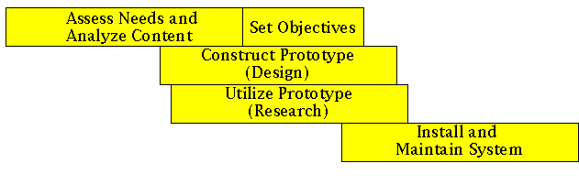
Rapid prototyping
In a design process, early development of a small-scale prototype used to test out certain key features of the design.
Rapid prototyping allows the designer to start with a low fidelity medium (such as paper and pen) and move to increasingly higher fidelity prototypes as time goes on.

Slide 59
Cont…
Rapid prototyping -- the spiral cycle:
concept definition
implementation of a skeletal system
user evaluation and concept refinement
implementation of refined requirements
user evaluation and concept refinement
implementation of refined requirements
Etc, etc in a continuous cycle

Slide 60
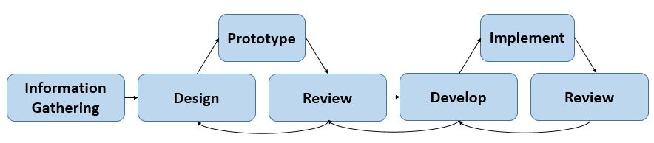

Slide 61
How content can be organized in rapid prototyping
Step 1 – Get attention: Grab attention by asking a relevant question on the subject or related to prior knowledge. Other ways to grab attention is by presenting a relevant fact, shock statement, image, video or important statistic.
Step 2 – Set direction: Be clear about what you are going to cover and how it will benefit the learner.
Step 3 – Present: Present all the relevant content concisely. In depth information should be added as attachments, additional resources or supplementary web links.
Step 4 – Show and Try: Demonstrate the learning through example or case study how the knowledge should be used. Ask questions to check comprehension.
Step 5 – Summarize: Give a clear wrap of the key information.
Step 6 – Action and Support: Show what to do next and where to get more support.

Slide 62
Integrating technology into the classroom / TPACK

Slide 63
Objectives
By the end of the unit, students would be able to;
describe the situation of teaching in Ghana with ICT
explain TPACK
develop a lesson plan using TPACK

Slide 64
“If we teach today as we taught yesterday, then we rob our children of tomorrow”
John Dewey

Slide 65
Ask yourself this question:
HOW DO WE TEACH IN GHANA?

Slide 66
Teaching in Ghana
Traditional teaching methods (teacher-centered approach dominates
Teachers do all the talking, students listen and write a lot of notes
Teacher questions requiring recall of facts
Heavy emphasis on assessment
Students do not take active participation (Hardly any hands-on activities)

Slide 67
What ICT can provide
Research shows teaching with non-linguistic activities (graphic organizers, mental images & movement) helps improve students’ understanding of concepts.
Research concludes cooperative group work leads to learning gains and higher student achievement. This interaction leads to more learning and great content retention.

Slide 68
ICT Education in Ghana
Even though studies from all over the world have shown the potential of ICT to enhance teaching and learning
Limited or no ICT integration in our context
Stand alone technology courses (at best)

Slide 69
Class Discussion (3 mins)
• Identify an ICT tool that you have used in your
teaching (if any) and elaborate on its
affordances
• Share with a partner
7

Slide 70
Why Integrate Technology?
We live in a complex, highly technological
knowledge-based economy
Analysis and problem solving skills
Challenging students intellectually
Introduce technology to deepen and enhance the
learning process
Technology can be used to support four key
components of learning
Active engagement with students
Participation in groups
Frequent interaction
Feedback

Slide 71
We live in an information age: Paradigm shift
Technology integration necessarily alters the traditional paradigm of the teacher providing wisdom and the student absorbing knowledge...and for good reason.
The knowledge needed for tomorrow’s jobs will change before many of today’s students enter the job market.
Students today must learn to search and discover knowledge, actively communicate with others, and solve problems so that they can become productive life-long members of our society.

Slide 72
21st century skills for students
Cooperation
Communication
ICT literacy
Social and/or cultural skills
Creativity
Critical thinking skills
Problem solving skills
Productivity
Learning to learn
Self directed learning
Planning
Flexibility
Math, Science, Languages
Taking risks
Metacognition
Controlling / solving conflicts
Initiative and entrepreneurism
Interdisciplinary skills

Slide 73
Change your role
Allow technology to change your teaching paradigm
When technology is effectively integrated into subject areas teachers grow into roles of
Advisor
Content expert
Coach

Slide 74
WHAT IS TPACK?
Technological Pedagogical Content Knowledge (TPACK) refers to the knowledge that emerges from an understanding of an interaction of content, pedagogy, and technology knowledge.
Coined by Mishra & Koelher

Slide 75
Why TPACK?
Learning “how to use” technology is different from knowing what to do with technology for teaching
A framework to understand teachers’ knowledge required for effective technology integration

Slide 76
Why TPACK?
Allows educators to bring ‘real world’ applications to the classroom
Provides an opportunity for students to see and hear video clips and audio which can help to teach or reinforce concepts.
Allows students to investigate, connect to and make discoveries previously unknown to the student.

Slide 77
OUR Context
In the classroom, it is important that the teacher must consider the
Concepts taught
The best way to teach the subject
And the technology that will enhance the lesson.
PK
CK
TK
PCK

Slide 78
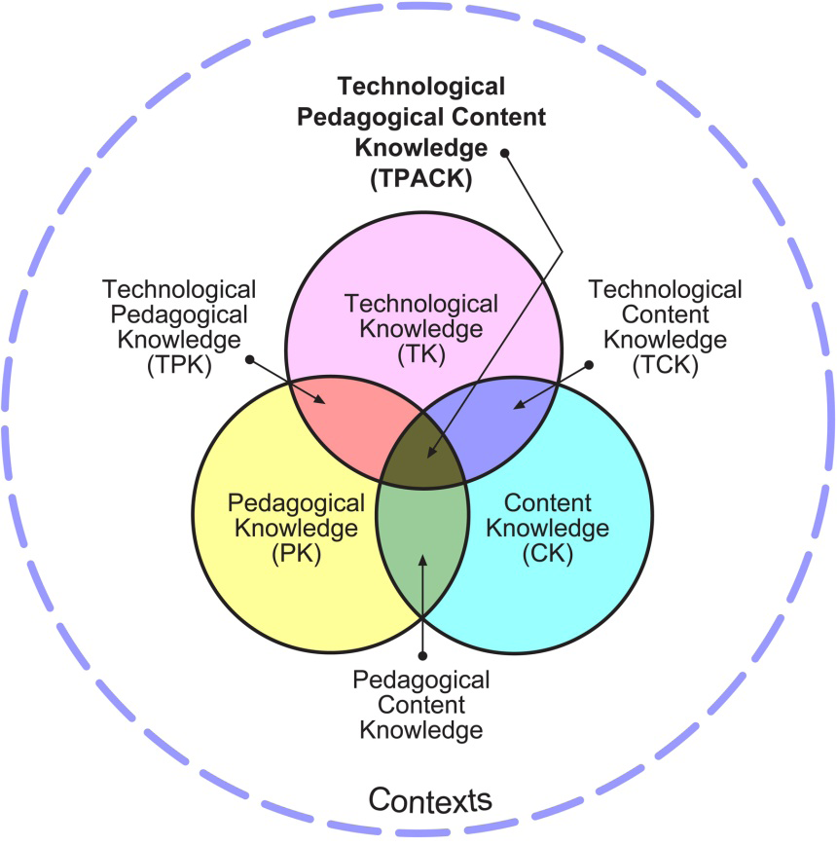
Ideal situation is the TPACK framework
Notes:
TPACK is the interaction of all 3 bodies of knowledge. Understanding goes beyond the knowledge of each in isolation. Instead it is how they react with each other.

Slide 79
CONTENT knowledge (CK)
Knowledge about the actual subject matter that is to be learned or taught
TECHNOLOGICAL knowledge (TK)
Knowledge about technologies and how to use them
PEDAGOGICAL knowledge (PK)
Knowledge of how we teach – teaching methods
Notes:
CK largely depends on age, level and subject matter. This knowledge includes concepts, theories, ideas, organizational frameworks, evidence and proof, as well as estabished practices and approaches toward developing such knowledge.
PK is deep knowledge about the processes and practices or methods of teaching and learning and hw it encompasses (among other things) overall educational purposes, values and aims. It applies to understanding how students learn, general management skills, lesson planning, and student assessment.
Understanding the impact of technology (TK) on the practices and knowledge of a given discipline is critical if we are to develop appropriate technological tools for educational purposes.

Slide 80
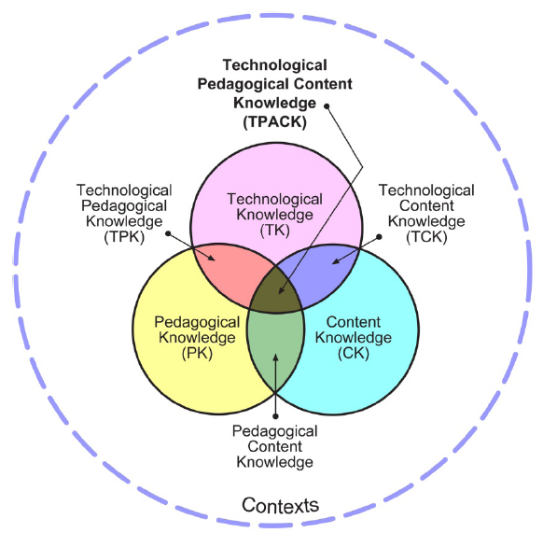
What is TPACK?
Technological (ICT) Knowledge
Skills necessary to operate particular technologies
The ability to learn and adapt to new technologies
A functional understanding of technologies
Pedagogical knowledge
Students’ prior knowledge
How to use resources
Classroom management
Lesson plan development & implementation
Student evaluation
Content or Subject matter knowledge
Knowledge of central facts, concepts, theories & procedures
Explanatory frameworks
Evidence for proof

Slide 81
Exercise 1
Lets try and explain the following
PCK
TCK
TPK

Slide 82
P
C
T
C
PCK
TCK
Knowledge of how to best teach the subject matter
Knowledge of how content is represented and transformed by the application of technology
T
P
TPK
Knowledge of how teaching and learning change when particular technologies are used

Slide 83
What is TPACK?
Technological pedagogical Knowledge:
How pedagogies change because of ICT (or how ict can support pedagogy)
Technological Content Knowledge:
How subject matter changes because of ICT (or how ict can support subject matter!)
Pedagogical Content Knowledge: How particular aspects of subject matter
are organized, adapted and represented for instruction

Slide 84
Activity 1
Identify TPACK elements in 3 Lesson Plans
In your groups study the lesson plans and see if you can identify some of the TPACK components in them.
Technological Knowledge (TK)
Pedagogical Knowledge (PK)
Content Knowledge (CK)
Technological Pedagogical Knowledge (TPK)
Technological Content Knowledge (TCK)
Pedagogical Content Knowledge (PCK) and
Technological Pedagogical Content Knowledge (TPACK)
Highlight TPACK elements you identify with codes
TK, PK, CK, TPK, CPK, TCK, TPACK

Slide 85
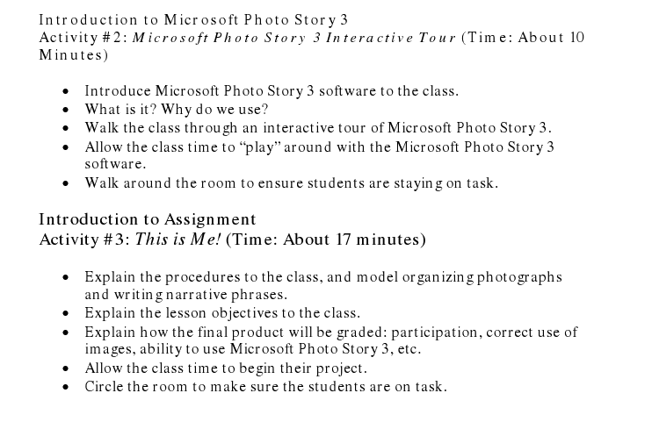
TPK & PK

Slide 86
Playing with technology
Blogs
Television
Computer
MP3, MP4
E-portfolio
Mobile phone
Wiki
iPod
Camera
GPS
CMS
Online games

Slide 87
Technology enhanced learning
Technology-enhanced learning is gaining favour since it emphasises how technology adds value to learning
Technology-enhanced learning is concerned with:
Connectivity to information and to others
Greater choice over the time, place and pace of study
Provides an alternative modes of study: distance, blended, work-based learning etc

Slide 88
21st century competencies of the teacher
Effective teaching depends on flexible access to rich, well-organized and integrated knowledge from different domains, including
knowledge of student thinking and learning (pedagogy)
knowledge of subject matter (content), and increasingly,
knowledge of technology
“At the heart of good teaching with technology are three core components: content, pedagogy, and technology, plus the relationships among and between them.”
(Koehler & Mishra, 2006)

Slide 89
Barriers to technological change
1. FEAR of change
2. TRAINING in basics
3. PERSONAL use
4. TEACHING models
5. LEARNING based
6. CLIMATE
7. MOTIVATION
8. SUPPORT

Slide 90
Challenges - technology integration in teaching
Many teachers earned degrees at a time when educational technology was at a lower stage of development than it is today
They do not consider themselves sufficiently prepared to use technology in the classroom
They do not have opportunities to explore the value of technology or its relevance to teaching and learning

Slide 91
How educators should be guided
Identify parts of the curriculum that are hard to teach where technology might help overcome pedagogical or cognitive difficulties.
Identify topics in the curriculum for which technology is an essential element of the science being taught.

Slide 92
Professional Learning Networks - PLNs

Slide 93
Objectives
By the end of the unit, students would be able to;
describe PLN
site examples of PLN
list the stages of PLN
state at least three ways PLNs helps teachers

Slide 94
Professional Learning Networks - PLNs
A PLN is one in which participants in a professional community learn together
Any group of people sharing the same profession or interests that share ideas
Your department is an example of a PLN
PLNs enable teachers and student teachers access to a wide range of experts and communities to support their professional learning.

Slide 95
Professional Learning Networks – PLNs cont…
P – It is building professional relationships with teachers, university professors and experts around the world. No matter your location in the world, there is always someone else to answer questions, and share their expertise.

Slide 96
Professional Learning Networks – PLNs cont…
L – It is about sharing ideas and resources, collaboration, and learning. We share our learning, ideas and expertise in different ways; using different media and tools.
N – It is a global learning network, enabling people to tap into and share diverse, global perspectives on teaching strategies, educational issues, and technologies.

Slide 97
Professional Learning Networks – PLNs cont…
The internet allows us to form PLNs with more people and much more easily
Why write a letter when you can email?
Why email when you can text/twitter?

Slide 98
PLN also Stands For Personal Learning Network
Informal Learning
“Just In Time” Learning
Social Learning Theory: Bandura, Vygotsky
Professional Learning Community-PLC
Notes:
Learning doesn’t always take place in the classroom. Informal learning describes the growth that we undertake in our day to day interactions. Just in time learning ask for help on something you need now. Social Learning-we learn by modeling. What if there is no one to model? Connect with other practitioners (not “outside experts”) but still outside.

Slide 99
The stages of PLN
Lurking/Skimming
Asking for help/opinions
Giving help/opinions
Starting something (group/discussion)
Joining every social network possible
Finding the right balance

Slide 100
PLNs & ICTs
PLNs can be facilitated through the use of a range of ICT tools
Professional learning communities and websites
Social networking sites (Facebook, Twitter, LinkedIn),
Social bookmarking tools (Diigo, Delicious),
Wikis (wetpaint, Wikispaces)
NB. Pick one username, use the same email, and a consistent password for all of your PLN sites

Slide 101

Social Networking - Twitter
Twitter is a popular resource for educators who want to connect with each other professionally
Twitter allows you to
‘follow’ professional communities and networks that you are interested in
and to be ‘followed’ by them.
Stimulating discussions, new resources, and an ongoing supportive network.
You just have to know where to look.

Slide 102

Diigo – Social Bookmarking Site
Diigo is a free social bookmarking tool that allows users to share online resources like websites and web tools in a private or public group format.
There are lots of different groups on Diigo, many for professional and educational use.
A place where you can store all your bookmarks, pictures, and notes too.
Use tags to classify
Your school, district, department, class could set up a tag to collect all of your finds
Can install a toolbar to make it easy to maintain and share a single list of bookmarks from any computer

Slide 103
Many Other Ways to Connect…
Curriki
http://www.curriki.org
Share lesson plans
Platform/Software specific discussions
http://www.moodle.org

Slide 104
How can PLNs help teachers?
Professional development – learn from content-area specialists;
Locate resources for your classroom, such as free websites and software;
Get lesson plan ideas from master teachers;
Learn about new technology and how to integrate it into your teaching;
Find collaborative solutions;
Find interesting links to education news.

Slide 105
PLN Extends That Tradition
PLNs helps teachers to get recommendations from other professionals, which makes it easier for me to find great resources.
Therefore teachers can share ideas, give their opinions and add their suggestions. Thus, making the internet human again.
For example,
If you have a favorite lesson, but don’t want to set up a website to share your opinions, knowledge, experience, and lesson plans you can jump into active online communities and get positive feedback!

Slide 106
Five Steps to building your PLN via Twitter
1. Join
Sign up for twitter.com and create a username.
Username should not be too long
Complete your bio so people know who you are, and add an image.
2. Follow
There are thousands of teachers around the world on Twitter.
Once you have a few people to follow, look at who they are following and you will start to build a PLN.

Slide 107
Five Steps to building your PLN via Twitter cont…
3. Lurk
You’ll need to spend some time checking out the streams of tweets and getting hang of
Tweeting
Retweeting
Direct messaging
Hashtags

Slide 108
Five Steps to building your PLN via Twitter cont…
4. Contribute
The more you put in, the more you get out.
Make sure you
Reply people
Retweet tweets
Ask questions
Strike up conversations

Slide 109
Five Steps to building your PLN via Twitter cont…
5. Stick with it!
Check on Twitter daily for a month before you make decisions about whether it is for you
It is about rapports with people and your professional world will be so enlightened.

Slide 110
Blogging
A blog is a way of sharing your knowledge with the world by writing regularly about your ideas in a particular area.
Steps
Decide what you are going to blog about
Choose a domain
Decide on the blogging platform
Start your blog
Design your blog
Start blogging

Slide 111
Assignment
Investigate & explore some online Professional Learning Networks
Based on your experience in (1) above design and develop your own Professional learning network (Twitter, Blog, LinkedIn Academia etc) and share with professionals in your learning community.

Slide 112
“It is not the strongest of the species that survives, nor the most intelligent that survives. It is the one that is most adaptable to change”
Charles Darwin

Slide 113
Using Instructional Software in Teaching and Learning

Slide 114
Objectives
By the end of the unit, students should be able to;
discuss the following instructional software:
Drill-and-practice
Tutorials
Simulations
Educational/Instructional games
Problem-Solving courseware

Slide 115
Drill and Practice Activities
The well-designed drill and practice programs should have the following elements:
1. Control over the presentation rate.
2. Appropriate feedback for correct answers.
3. Better reinforcement for correct answers.
Most basic drill and practice functions are often described as a flashcard activity.

Slide 116
Using Drill and Practice Software in Teaching
Immediate feedback
Motivation
Saving teacher time
In place of or supplemental to worksheets and homework
In preparation for tests

Slide 117
Tutorial Activities
Tutorials are used to deliver entire instructional sequences similar to a teacher’s classroom instruction.
Courseware focuses on the acquisition stage of learning.
Tutorials are often categorized as linear and branching (Alessi and Trollip,1991).

Slide 118
Tutorial Activities( cont.)
A linear tutorial gives its user the same instructional sequence of explanation, practice, and feedback regardless of differences in user performance (IETIT p.89).
Some tutorials have computer-management capabilities. Data collection and management features make tutorials more useful to teachers.

Slide 119
The Elements of Well-Designed Tutorial Programs
Tutorials are geared toward learners who can read fairly well and usually older students or adults.
Extensive interactivity.
Thorough user control.
Appropriate and comprehensive teaching sequences.
Adequate answer-judging and feedback capabilities.

Slide 120
Tutorials
Tutorials (teacher-directed methods) deliver traditional instruction in skills rather than letting students create learning experiences through generative exercises and project development.
Tutorials in Teaching:
1. Self-paced reviews of instruction
2. An alternative learning strategy.
3. Permit instruction when teachers are unavailable.

Slide 121
Simulation Activities
A simulation is a computerized model of a real or imagined system designed to teach how a certain system or a similar one works(IETIT p93).
Simulations differ from tutorial and drill and practice activities because they provide less structured and more learner-directed activities.

Slide 122
Types of Simulations
Physical simulations:
Users manipulate objects
Process simulations:
Usually use for biological simulations
Procedural simulations:
Used for medical or mechanical problems and flight simulators
Situational simulations:
Hypothetical problem situations & reactions to them

Slide 123
Using Simulations in Teaching
Compress time.
Slow down processes.
Get students involved.
Make experimentation safe.
Make the impossible possible.
Save money and other resources.
Repeat with variations.
Make situations controllable.
Supplement or replace lab experiments.

Slide 124
Instructional Games
Games are usually listed as a separate form of courseware because their instructional connotation to students is slightly different. (IETIT p99).
The function of a games is to hold student’s attention or supply a reward for accomplishing other activities.

Slide 125
Types of Games
Adventure
Arcade
Board
Cards
Combat
Logic
Role-playing
TV quizzes.
Word

Slide 126
Instructional Game Issues
Many educators believe that games, especially computer-based ones, are overused and misused (McGinley, 1990).
Others believe that games convince students that they are “escaping from learning,” and games draw attention away from learning.

Slide 127
Problems with Games & Their Use in Teaching
Other teachers worry that students can become confused about which part of the activity is the game and which part is the skill they are learning.
Difficulty transferring skills to nongame situations.
Teaching with Games:
Replacement for worksheets and exercises
Foster cooperation and group work
As a reward

Slide 128
Problem-Solving Courseware
Synonyms term for problem-solving include: critical thinking, thinking skills, higher level thinking, higher-order cognitive outcomes, reasoning, use of logic, decision making, and inference skills.
Mayes(1992)- “ teaching-sequenced planning to solve problems to high ability learners could interfere with their own effective processing”(p101).

Slide 129
Six Steps Help Teachers Integrate P-S Courseware
1. Identify problem-solving skills or general capabilities to build or foster:
a. Solving one or more kinds of content -
area problems.
b. Using a scientific approach to problem
solving.
c. Components of problem solving.
2. Decide on a series of activities that would
help teach the desired skills.

Slide 130
Cont…
3. Examine courseware to locate materials that closely match the desired abilities.
4. Determine where the courseware fits into the teaching sequence.
5. Demonstrate the courseware and the steps to follow in solving problems.
6. Build in transfer activities and make students aware of the skills they are using in the courseware (IETIT p103).

Slide 131
Seven Steps for Integrating Problem-Solving Courseware
1. Allow students sufficient time to explore and interact with the software; provide some structure in the form of directions, goals, a work schedule, and organized times for sharing and discussing results.
2. Vary the amount of direction and assistance depending on the needs of each student.

Slide 132
Cont…
3. Promote a “ reflective learning environment;” let students talk about their work and the methods they use.
4. Stress thinking processes rather than correct answers.
5. Point out the relationship of courseware skills and activities to other kinds of problem solving.

Slide 133
Cont…
6. Let students work together in pairs or small group.
7. If assessments are done, use alternatives to traditional paper-and pencil tests (IETIT p105).

Slide 134
Required Instructional Design and Pedagogy
Appropriate teaching strategy, based on best-known methods
Presentations contains nothing that misleads or confuses students
Comments that are not abusive or insulting
Readability at an appropriate level for students
Graphics that are not distracting to learners.

Slide 135
Required for Content
No grammar, spelling, or punctuation errors on the screen
Accurate, up-to date content
No racial or gender stereotypes
Social characteristics exhibiting sensitivity to moral values

Slide 136
Required for User Flexibility
User has some control of movement within the program
User can Can turn off sound, if desired

Slide 137
Required Technical Soundness
Program loads consistently, without error
Program does not break, no matter what the student enters
Program does what the screen says it should do

Slide 138
Optional Student Use Criteria
Student ease of use
Required keys
Input devices
Directions
Supportive materials
Optional assistance
Optional directions
Creativity
Summary feedback

Slide 139
Optional Teacher Use Criteria
Teacher’s ease of use
Management
Teacher manuals
Ease of integration
Teacher assistance
Adaptability

Slide 140
Optional Presentation Criteria
Graphics features
Screen layout
Speech capabilities
Required peripherals

Slide 141
Optional Technical Criteria
Response Judging
Timing
Portability
Compatibility
Technical Manuals

Slide 142
Possible Internet resources and searching skills

Slide 143
Objectives
By the end of this unit, the student would be able to:
Explain the three classification of ICT resources.
Use a diagram to show a search strategy for finding information on the internet.
Develop a PowerPoint presentation.

Slide 144
Internet resources
A classification of ICT resources is presented in three main areas:
information resources (e.g., webgraphy and online databases),
collaboration resources (e.g., blogs and wikis)
learning resources (e.g., webquest, repositories of educational resources, podcasts and m-learning).

Slide 145
ICT Information Resources
ICT resources provide additional information to address a topic from basic to advanced levels.
Teachers are facing a new scenario which offers ample flexibility and availability of data sources and direct access to web resources.
ICT and information resources can provide updated data in different media formats.
Some ICT Information Resources will include the following: Webgraphy, virtual encyclopedias, online databases, web 2.0 tools (e.g., social bookmarks, YouTube and Slideshare) and visual search engines based on web 3.0 (semantic web)

Slide 146
ICT Collaboration Resources
ICT resources for collaboration offer users the opportunity to participate in professional networks and co-create resources.
Collaborative work allows the assessment of existing resources and their use in different contexts and then analyzes these resources to enable their creative use in collaborative learning contexts.
Some collaborative ICT resources are mailing lists, groups and collaborative web 2.0 tools such as wikis and blogs. Webinar is a widely used tool for organizing online seminars.

Slide 147
ICT learning resources
ICT resources for learning offer the possibility of acquiring knowledge, attitudes and procedures during the teaching process. ICT resources offer various forms of work with content and activities. An integrated design of learning resources is an important part of the instructional process that helps achieve the expected learning outcomes. Some ICT learning resources are repositories of educational resources, interactive tutorials, online quizzes, web 2.0 tools (e.g., eBooks, podcasts) and open online courses

Slide 148
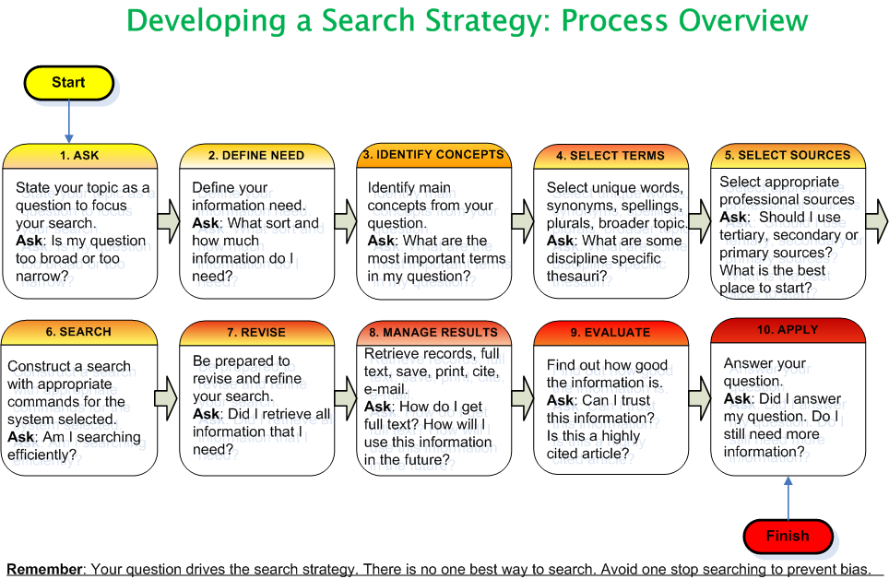
Planning a Search Strategy
Notes:
This Section of the AGORA Short Course is an overview of the basic search strategies (Boolean Operators and other techniques) that will be useful when you want to identify specific articles using keywords to search in bibliographic databases. Also covered are how to plan a search strategy, evaluating Internet-based information and comparing keyword search results using Google and Google Scholar.
This and the subsequent slide summarize the steps for effective searching. The initial steps can be completed prior to accessing the Internet and a specific database or resource. This is advisable when there is low-bandwidth and high-cost for Internet access.

Slide 149
Boolean Operators
AND Operator (to combine two concepts)
livestock
drought
the AND operator is used to combine two concepts e.g. livestock AND drought – results are in the combined area of the two circles
Notes:
We now will view a series of searches using the Boolean operators. Using the AND operator makes this search more precise or limited.

Slide 150
AND Operator (to combine three concepts)
bean
cultivation
pests
the AND operator is used to combine three concepts e.g. bean AND cultivation AND pests - in the combined area of the three circles
Notes:
Note that the three combined AND terms make the search even more precise/limited.

Slide 151
OR Operator (info containing one or other term)
beans
legumes
the OR is a means of combining synonyms e.g. beans OR legumes - in each circle’s area with the overlap in the middle having both search terms
Notes:
In contrast to the AND search operator, the OR one expands the search. We have used two terms that are synonyms and have expanded the results.

Slide 152
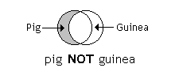
NOT Operator (in one term or the other)
pig NOT guinea – in the shaded area; eliminates items in 2nd term (guinea) or both terms
Notes:
Using the NOT operator, this search is for livestock pigs (swine) and eliminates any articles about guinea pigs (often used for research experiments). Note that a byproduct of this search also would eliminate any material from the countries ‘Guinea’ and ‘Papua New Guinea’.

Slide 153
Other search engine functions
Phrase or proximity searching: “…” or (…)
allows you to search for an exact phrase, e.g. pests and (bean cultivation)
Truncation/wildcards: *
allow you to search alternative spellings and plurals
river* for river OR rivers
pesticide* for pesticide OR pesticides
program* for programme or program
Alternate spellings: ?
can be used to substitute for characters anywhere in a word
wom?n for woman or women
Notes:
A search for (bean cultivation) would include both bean AND cultivation. While many search engines and databases contain these options, the exact terminology may differ [e.g. for proximity searching “…” or (…) ]. For example, in Google, the AND Boolean Operator is automatically used. A search for (bean cultivation) would include both bean AND cultivation.

Slide 154
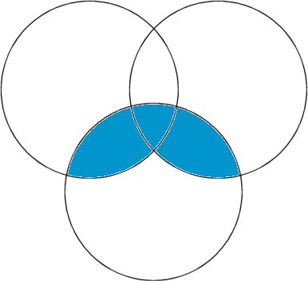
Africa AND (bean OR maize)
bean
maize
Africa
Africa AND (bean or maize) – in the shaded area
The (OR) operator retains items in each term and the AND operator is used to combine two concepts
Notes:
By combining AND plus proximity searching with the OR operator, we have expanded a search to include to two broad subjects and use a geographic limit.

Slide 155
POWERPOINT PRESENTATIONS

Slide 156
What is PowerPoint?
PowerPoint is a computer program that allows you to create and show slides to support a presentation. You can combine text, graphics and multi-media content to create professional presentations. As a presentation tool PowerPoint can be used to:
organise and structure your presentation;
create a professional and consistent format;
provide an illustrative backdrop for the content of your presentation;
animate your slides to give them greater visual impact.

Slide 157
Planning the Presentation
Know your audience
Objectives
Content
Resources
Design and instructional mode and strategies

Slide 158
Common Presentation Mistakes
Failing to master your topic
Getting another person to prepare the presentation for you
Stacking in too much information
Choosing a poor design template or design theme
Using unusual colour combination

Slide 159
CONT…
Poor font choices
Easy to read fonts are Arial or Times New Roman
Using extraneous photos and graphs
Using too many slides in one presentation
Using varying animations in one presentation
Hardware glitches (Projector or computer fail you)

Slide 160
Creating a Presentation with PowerPoint
Powerpoint Editing Tools
Slide Master
Add Text
Add Picture
Add Graphic

Slide 161
Creating a Presentation with PowerPoint
Add Video
Add Animation
Create Navigation Hyperlinks
Convert PowerPoint into Video

Slide 162
Downloading Multimedia From The Web
SaveFrom
http://en.savefrom.net/
Helper: http://en.savefrom.net/user.php?helper=1&download=setup&rmode=false
Savemedia
http://savemedia.com/
Keepvid
http://keepvid.com/
Creating PowerPoint Presentations

Slide 163
Downloading Multimedia From The Web
Using Savefrom.net/ Savemedia/ Keepvid
Go to Youtube.com
Select the video file
Start playing the file
Copy the URL in YouTube address Bar

Slide 164
Downloading Multimedia From The Web
Go to savefrom.net
Paste the copied URL
Press the Enter in savefrom.net text box
Choose video format MPG 4/480p/720p
Check download folder for the downloaded video file

Slide 165
References
https://willscotti.files.wordpress.com/2016/03/instructional-systems-design.pdf
Roblyer, M. D. & Doering, A. H. (2010). Integrating Education Technology into Teaching. United States of America: Allyn & Bacon.
Source: Source: Wendy Russell http://presentationsoft.about.com/od/presentationmistakes/tp/080722_presentation_mistakes.htm

